Slide 1
SAS vs. R vs. Python
Louis Tsang

Slide 2



What is…?
- SAS has been the undisputed market leader in commercial analytics space. It is well-supported.
- The software offers huge array of statistical functions, has good GUI.
- $$$
- R is the Open source counterpart of SAS, which has traditionally been used in academics and research.
-Because of its open source nature, latest techniques get released quickly.
- Large array of documentation and packages
- Free!!
- With origination as an open source scripting language, Python usage has grown over time.
- Today, it sports libraries (numpy, scipy and matplotlib) and functions for almost any statistical operation / model building you may want to do.
- Free!!

Slide 3
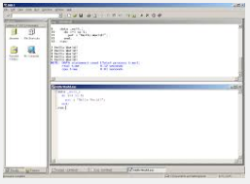
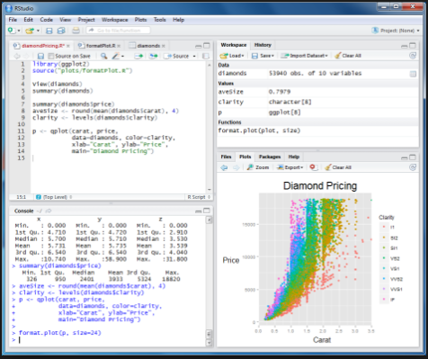
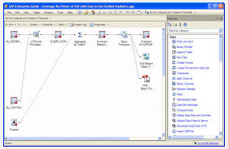
What is…?

Slide 4
Comparison
Dimension of Comparison | SAS | R | Python
Availability / Cost | 2 | 5 | 5
Ease of Learning | 4.5 | 2.5 | 3.5
Data Handling Capabilities | 4 | 4 | 4
Graphical/Visualisation | 3 | 4.5 | 4
Advancement in Tools | 4 | 4.5 | 4
Job Scenario | 4 | 3.5 | 3
Customer Service / Support | 4 | 3 | 3.5
Comparison done on a 1 – 5 scale, 1 being least desirable to 5 being the most desirable.
Source: “SAS vs. R (vs. Python) – which tool should I learn?” - 2014 - http://www.analyticsvidhya.com/blog/2014/03/sas-vs-vs-python-tool-learn/
Notes:
. Availability / Cost
SAS is a commercial software. It is expensive and still beyond reach for most of the professionals (in individual capacity). However, it holds the highest market share in Private Organizations. So, until and unless you are in an Organization which has invested in SAS, it might be difficult to access one.
R & Python, on the other hand are free and can be downloaded by any one. Here are my scores on this parameter:
SAS – 2
R – 5
Python – 5
2. Ease of Learning
SAS is easy to learn and provides easy option (PROC SQL) for people who already know SQL. Even otherwise, it has a good stable GUI interface in its repository. In terms of resources, there are tutorials available on websites of various university and SAS has a comprehensive documentation. There are certifications from SAS training institutes, but they again come at a cost.
R has the steepest learning curve among the 3 languages listed here. It requires you to learn and understand coding. R is a low level programming language and hence simple procedures can take longer codes.
Python is known for its simplicity in programming world. This remains true for data analysis as well. While there are no widespread GUI interfaces as of now, I am hoping Python notebooks will become more and more mainstream. They provide awesome features for documentation and sharing.
SAS – 4.5
R – 2.5
Python – 3.5
3. Data Handling Capabilities
This used to be an advantage for SAS till some time back. R computes every thing in memory (RAM) and hence the computations were limited by the amount of RAM on 32 bit machines. This is no longer the case. All three languages have good data handling capabilities and options for parallel computations. This I feel is no longer a big differentiation. Also, I might not be aware of the latest innovation in each ecosystem and hence I see all 3 as equally capable.
SAS – 4
R – 4
Python – 4
4. Graphical Capabilities
SAS has decent functional graphical capabilities. However, it is just functional. Any customization on plots are difficult and requires you to understand intricacies of SAS Graph package.
R has the most advanced graphical capabilities among the three. There are numerous packages which provide you advanced graphical capabilities.
Python capabilities will lie somewhere in between, with options to use native libraries (matplotlib) or derived libraries (allowing calling R functions).
SAS – 3
R – 4.5
Python – 4
5. Advancements in Tool
All 3 ecosystems have all the basic and most needed functions available. This feature only matters if you are working on latest technologies and algorithms.
Due to their open nature, R & Python get latest features quickly (R more so compared to Python). SAS, on the other hand updates its capabilities in new version roll-outs. Since R has been used widely in academics in past, development of new techniques is fast.
Having said this, SAS releases updates in controlled environment, hence they are well tested. R & Python on the other hand, have open contribution and there are chances of errors in latest developments.
SAS – 4
R – 4.5
Python – 4
6. Job Scenario
Globally, SAS is still the market leader in available corporate jobs. Most of the big organizations still work on SAS. R / Python, on the other hand are better options for start-ups and companies looking for cost efficiency. Also, number of jobs on R / Python have been reported to increase over last few years. Here is a trend widely published on internet, which shows the trend for R and SAS jobs. Python jobs for data analysis will have similar trend as R jobs:
Source: r4stats.com
In India, specifically, the gap in SAS vs. R is bigger. My estimate is that SAS would have about 70% of market share, R around 15% and Python less than 5%. However, the trends are similar to global trends.
SAS – 4.5
R – 3.5
Python – 2.5
7. Customer Service Support & Community
R has the biggest online community but no customer service support. So if have trouble, you are on your own. You will get a lot of help though. Similar for python, though at a lower scale.
SAS on the other hand has dedicated customer service along with the community. So, if you have problems in installation or any other technical challenges, you can reach out to them.
SAS – 4
R – 3.5
Python – 3

Slide 5

And the winner…?
…Depends...
Notes:
Other Factors:
Following are some more points worthy to note:
Python is used widely in web development. So if you are in an online business, using Python for web development and analytics can provide synergies
SAS used to have a big advantage of deploying end to end infrastructure (Visual Analytics, Data warehouse, Data quality, reporting and analytics), which has been mitigated by integration / support of R on platforms like SAP HANA and Tableau. It is still, far away from seamless integration like SAS, but the journey has started.
Clearly, there is no winner in this race yet. It will be pre-mature to place bets on what will prevail, given the dynamic nature of industry. Depending on your circumstances (career stage, financials etc.) you can add your own weights and come up with what might be suitable for you. Here are a few specific scenarios:
If you are a fresher entering in analytics industry (specifically so in India), I would recommend to learn SAS as your first language. It is easy to learn and holds highest job market share.
If you are some one who has already spent time in industry, you should try and diversify your expertise be learning a new tool.
For experts and pros in industry, people should know at least 2 of these. That would add a lot of flexibility for future and open up new opportunities.
If you are in a start-up / freelancing, R / Python is more useful

Slide 6
Demand
The number of scholarly articles found in each year by Google Scholar. Only the top six “classic” statistics packages are shown.
The number of analytics jobs for the more popular software (250 jobs or more, 2/2014).

Slide 7
Demand
Software used in data analysis competitions in 2011 (checked in 2016).
Lavastorm, Inc. conducted a survey analytic communities including LinkedIn’s Lavastorm Analytics Community Group, Data Science Central and KDnuggets.
Number of people who follow each software on LinkedIn and Quara.

